Slide 1
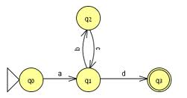
Pumping Lemma and Its Applications
Course Instructor: Dr. Sohail Iqbal
Book: Prof. Sipser-MIT
Slides: Prof. Busch - LSU

Slide 2
Non-regular languages
Regular languages

Slide 3
How can we prove that a language
is not regular?
Prove that there is no DFA or NFA or RE
that accepts
Difficulty: this is not easy to prove
(since there is an infinite number of them)
Solution: use the Pumping Lemma !!!

Slide 4

The Pigeonhole Principle

Slide 5
pigeons
pigeonholes

Slide 6
A pigeonhole must
contain at least two pigeons

Slide 7
pigeons
...........
pigeonholes
...........

Slide 8
The Pigeonhole Principle
pigeons
pigeonholes
There is a pigeonhole
with at least 2 pigeons
...........

Slide 9
The Pigeonhole Principle and DFAs

Slide 10
Consider a DFA with states

Slide 11
Consider the walk of a “long’’ string:
(length at least 4)
A state is repeated in the walk of

Slide 12
The state is repeated as a result of
the pigeonhole principle
Walk of
Pigeons:
(walk states)
Are more than
Nests:
(Automaton states)
Repeated
state
Repeated
state

Slide 13
Consider the walk of a “long’’ string:
(length at least 4)
Due to the pigeonhole principle:
A state is repeated in the walk of

Slide 14
The state is repeated as a result of
the pigeonhole principle:
Walk of
Pigeons:
(walk states)
Are more than
Nests:
(Automaton states)
Automaton States
Repeated
state

Slide 15
In General:
If ,
by the pigeonhole principle,
a state is repeated in the walk
Walk of
....
....
....
Arbitrary DFA
......
......
Repeated state

Slide 16
Number of states in walk is at least
Walk of
Pigeons:
(walk states)
....
....
....
Are
more
than
....
....
Nests:
(Automaton states)
A state is
repeated

Slide 17
The Pumping Lemma

Slide 18
Take an infinite regular language
(contains an infinite number of strings)
There exists a DFA that accepts
states

Slide 19
Take string with
(number of
states of DFA)
then, at least one state is repeated
in the walk of
Walk in DFA of
......
......
Repeated state in DFA

Slide 20
There could be many states repeated
Take to be the first state repeated
One dimensional projection of walk :
First
occurrence
Second
occurrence
....
....
....
Unique states

Slide 21
We can write
One dimensional projection of walk :
First
occurrence
Second
occurrence
....
....
....

Slide 22
In DFA:
Where corresponds to substring
between first and second occurrence of
...
...
...
...

Slide 23
Observation:
length
number
of states
of DFA
...
Because of
unique states in
...
Since, in no
state is repeated
(except q)

Slide 24
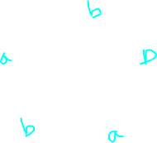
Observation:
length
Since there is at least one transition in loop
...

Slide 25
We do not care about the form of string
may actually overlap with the paths of and
...
...

Slide 26
Additional string:
The string
is accepted
Do not follow loop
...
...
...
...

Slide 27
Additional string:
The string
is accepted
Follow loop
2 times
...
...
...
...

Slide 28
Additional string:
The string
is accepted
Follow loop
3 times
...
...
...
...

Slide 29
In General:
The string
is accepted
Follow loop
times
...
...
...
...

Slide 30
Therefore:
Language accepted by the DFA
...
...
...
...

Slide 31
In other words, we described:
The Pumping Lemma !!!

Slide 32
The Pumping Lemma:
Given a infinite regular language
there exists an integer
(critical length)
for any string with length
we can write
with and
Then:
Notes:
Note. Here critical length in denoted by m;
In Siper’s book, the same is denoted by p, called pumping length.

Slide 33
Questions?
Practice Pumping Lemma

Slide 34
Applications of the Pumping Lemma

Slide 35
Recap: The Pumping Lemma:
Given a infinite regular language
there exists an integer
(critical length)
for any string with length
we can write
with and
Then:

Slide 36
Observation:
Every language of finite size has to be regular
(we can easily construct an NFA
that accepts every string in the language)
Therefore, every non-regular language
has to be of infinite size
(contains an infinite number of strings)

Slide 37
Suppose you want to prove that
αn infinite language is not regular
1. Assume the opposite: is regular
2. The pumping lemma should hold for
3. Use the pumping lemma to obtain a
contradiction
4. Therefore, is not regular

Slide 38
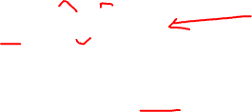
Explanation of Step 3: How to get a contradiction
1. Let be the critical length for
2. Choose a particular string which satisfies
the length condition
3. Write
4. Show that
for some
5. This gives a contradiction, since from
pumping lemma

Slide 39
Note:
It suffices to show that
only one string
gives a contradiction
You don’t need to obtain
contradiction for every

Slide 40
Example of Pumping Lemma application
Theorem:
The language
is not regular
Proof:
Use the Pumping Lemma

Slide 41
Assume for contradiction
that is a regular language
Since is infinite
we can apply the Pumping Lemma

Slide 42
Let be the critical length for
Pick a string such that:
and length
We pick

Slide 43
From the Pumping Lemma:
we can write
with lengths
Thus:

Slide 44
From the Pumping Lemma:
Thus:

Slide 45
From the Pumping Lemma:
Thus:

Slide 46
BUT:
CONTRADICTION!!!

Slide 47
Therefore:
Our assumption that
is a regular language is not true
Conclusion:
is not a regular language
END OF PROOF

Slide 48
Non-regular language
Regular languages

Slide 49
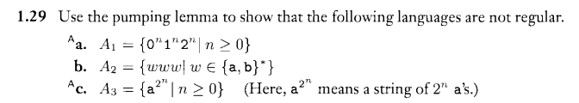
Practice
Prove that language of palindromes of even length is not regular.
Solve questions 1.29 from the Sipser’s book.

Slide 50
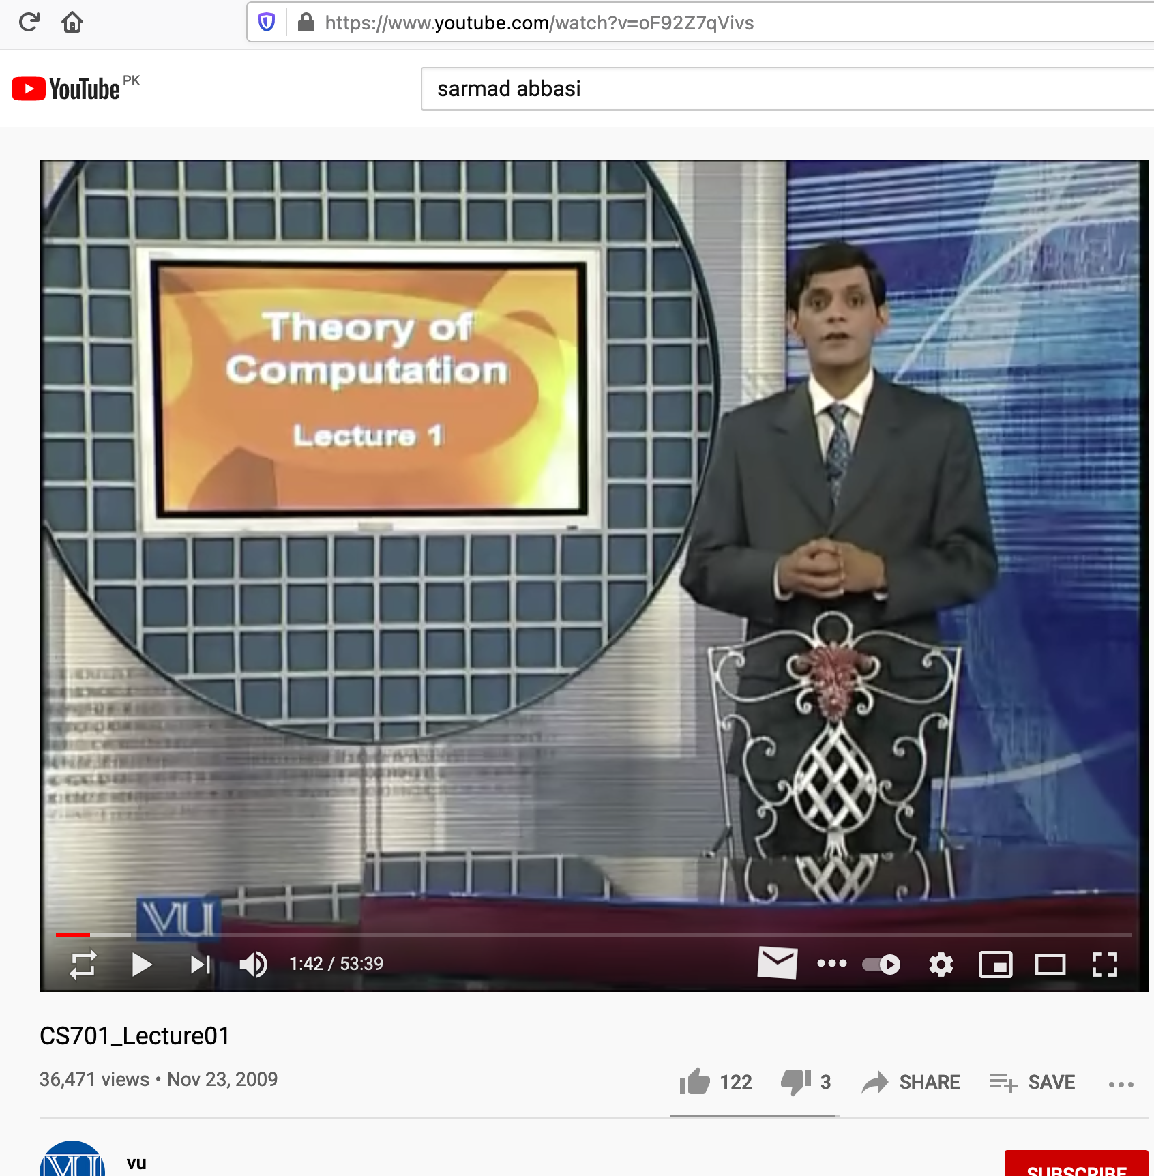
Dr. Sarmad Abbasi Best Theoretical Computer Scientist of Pakistan
Lecture 01 is included for exam
https://www.youtube.com/watch?v=oF92Z7qVivs

Slide 51
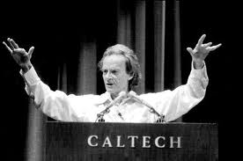
Interesting Note
In 1982, the Nobel prize-winning physicist Richard Feynman thought up the idea of a 'quantum computer',
a computer that uses the effects of quantum mechanics for computation model
Michael Sipser et al., with the deep understanding of Theory of Computation proposed Adiabatic quantum computation
Thanks

